Slide 1
React Native
李剑

Slide 2
React
React (sometimes styled React.js or ReactJS) is an open-source JavaScript library for data rendered as HTML.

Slide 3
传统的网站开发
HTML（控制内容）
CSS（控制样式）
JavaScript（控制行为）

Slide 4
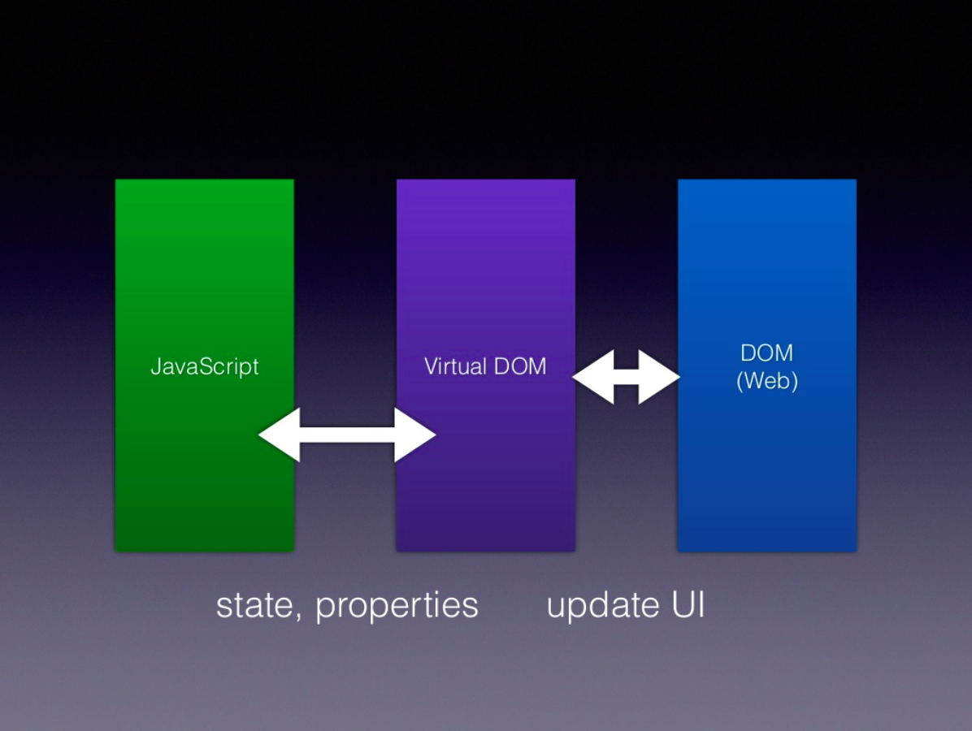
React

Slide 5
React
映射
JavaScript对象
HTML元素
// Note: this structure is simplified
{
type: 'h1',
props: {
className: 'greeting',
children: 'Hello, world'
}
};
<h1 class=“greeting”>Hello, world</h1>
// JSX
<h1 className="greeting">
Hello, world!
</h1>

Slide 6
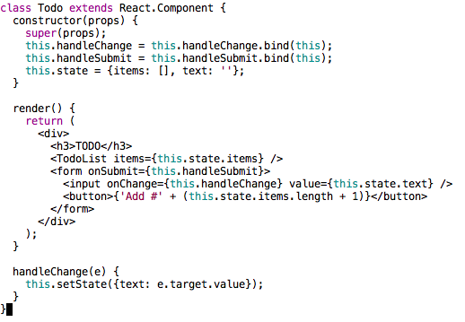

React

Slide 7
React

Slide 8
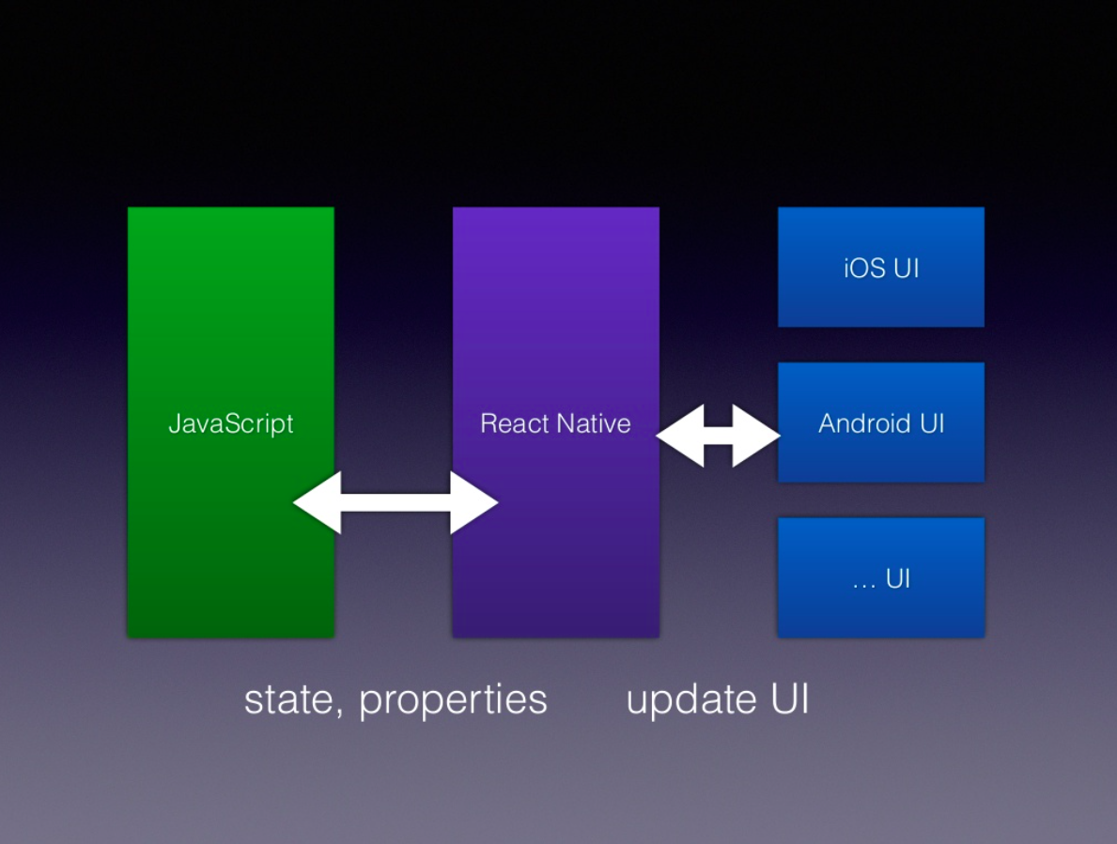
React Native

Slide 9
React Native
React Native lets you build mobile apps using only JavaScript. It uses the same design as React, letting you compose a rich mobile UI from declarative components.
——facebook.github.io/react-native
使用JavaScript语言和React框架编写跨平台移动应用，但是UI是完全原生的，体验和原生app几乎一致。

Slide 10
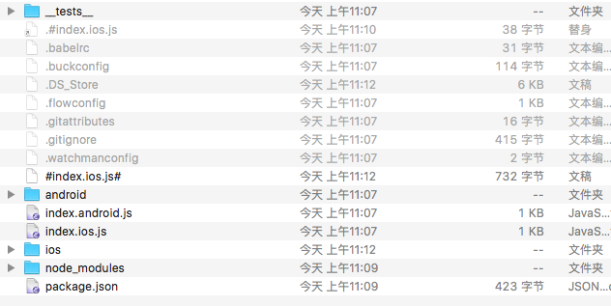
React Native

Slide 11
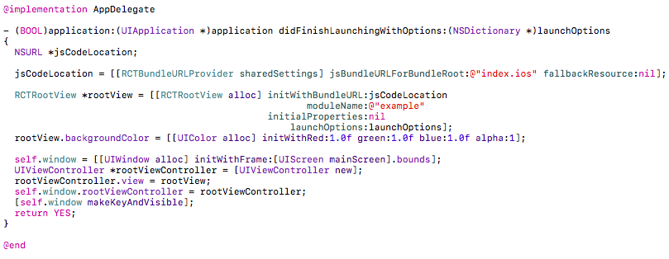
React Native
AppDelegate.m

Slide 12
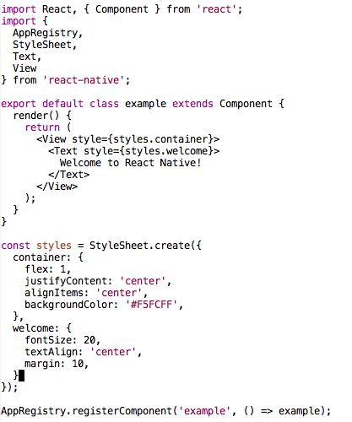

index.ios.js

Slide 13
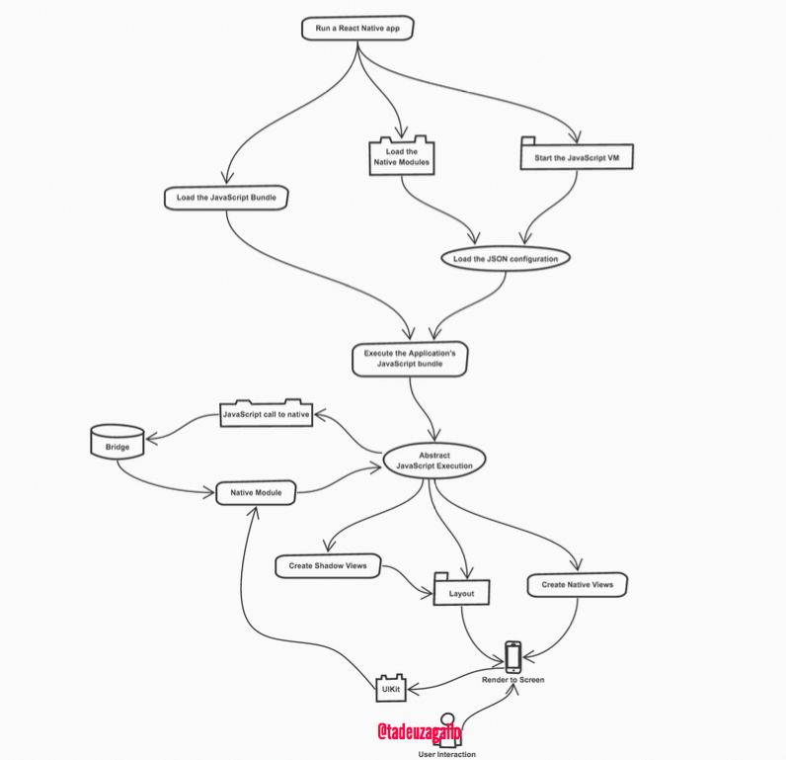

Slide 14
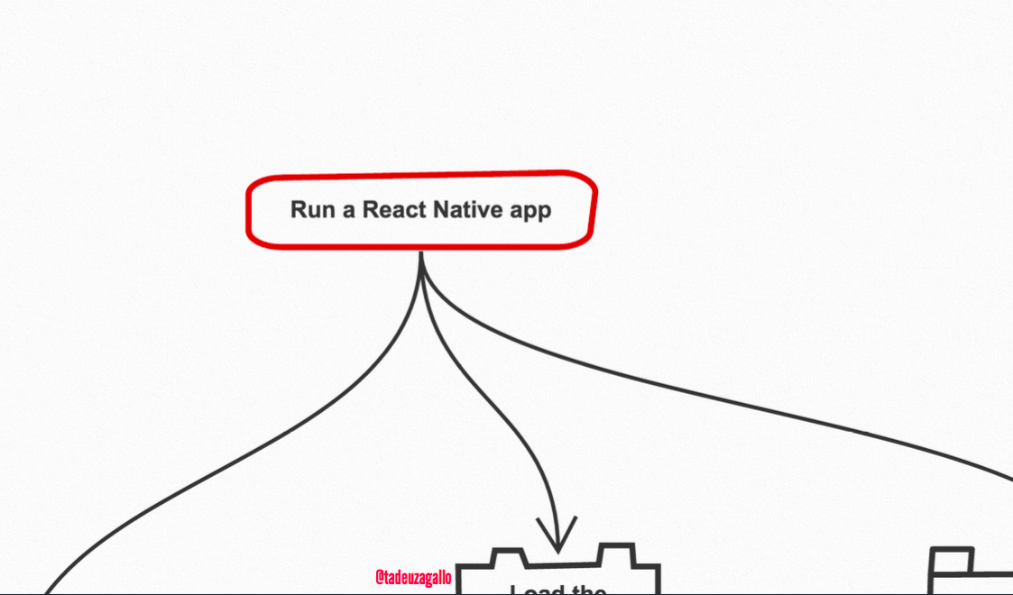

Slide 15
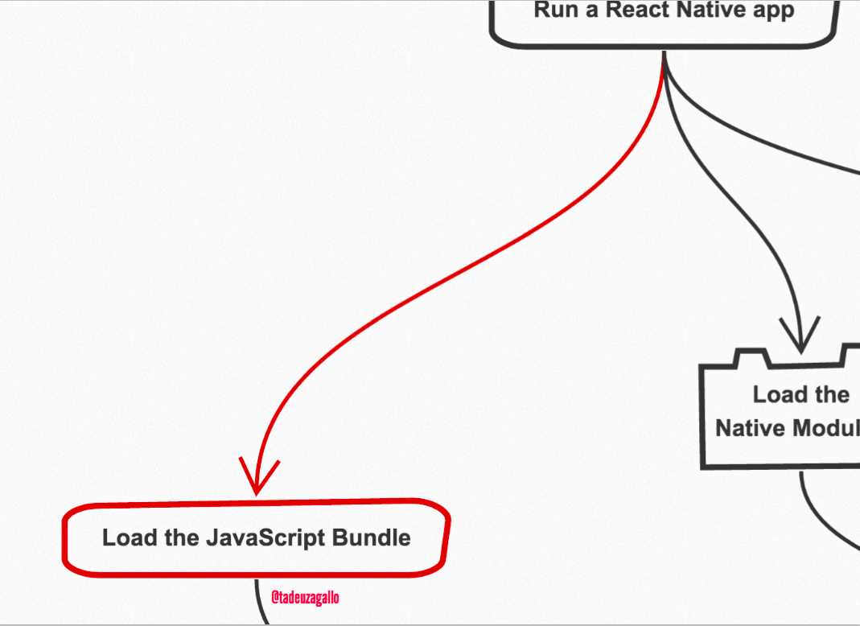

Slide 16
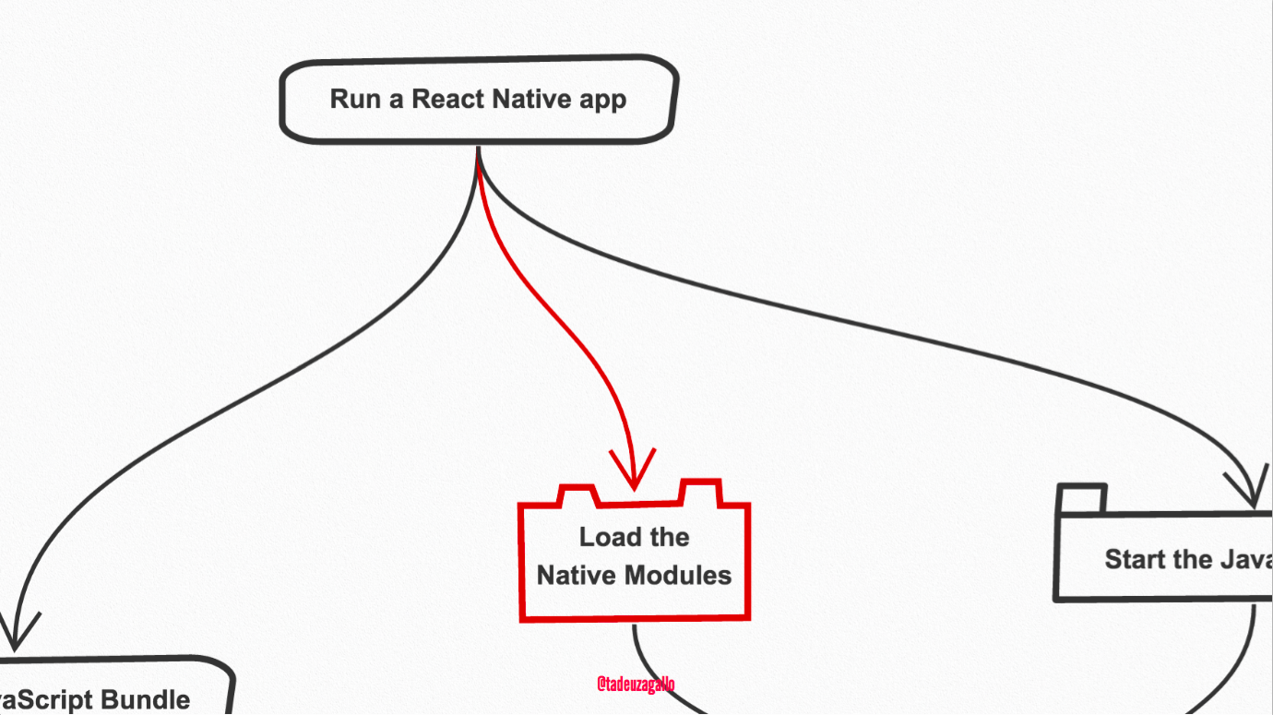

Slide 17
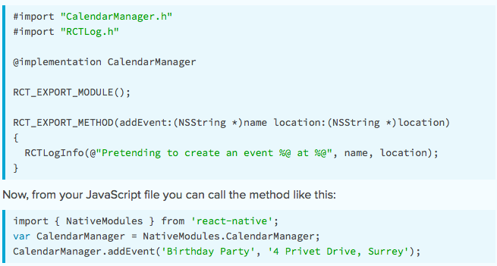

Slide 18
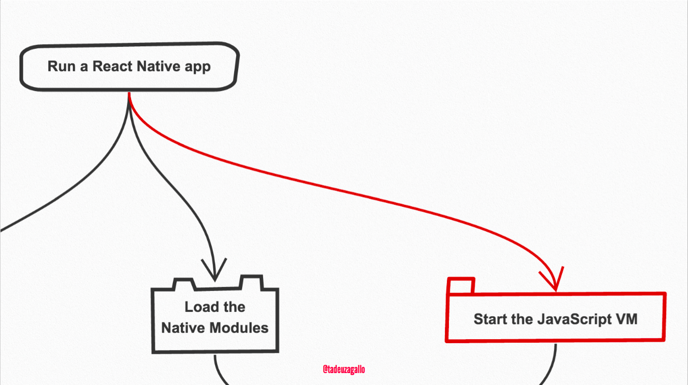

Slide 19


Slide 20
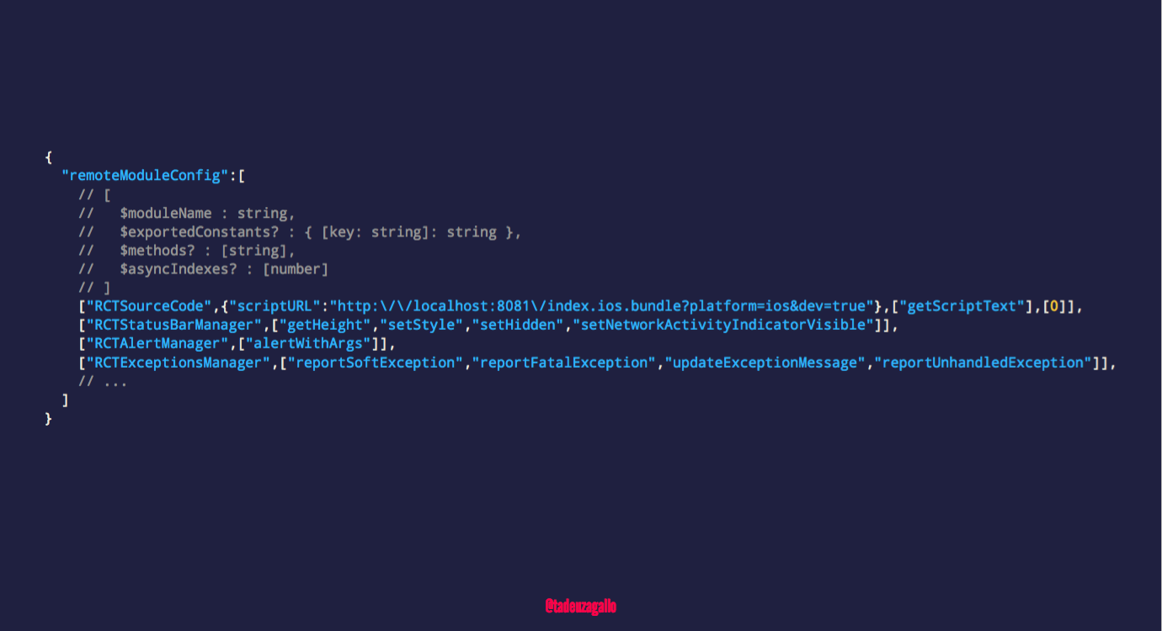

Slide 21


Slide 22


Slide 23
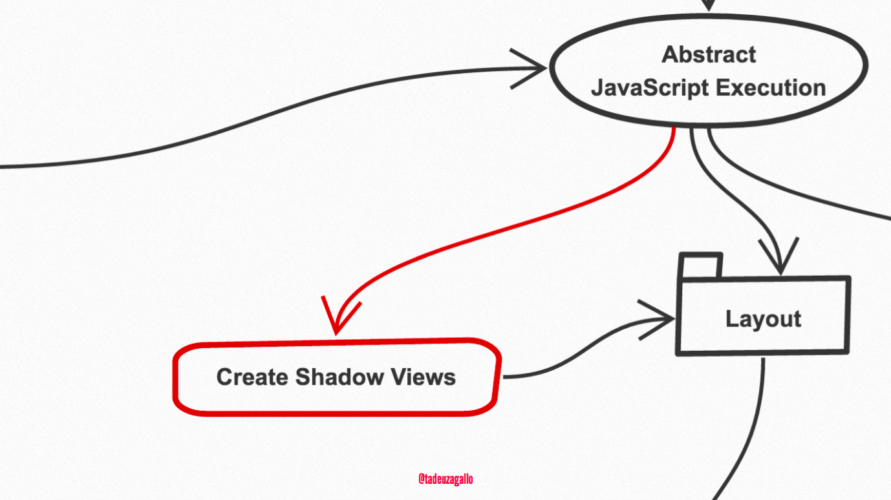

Slide 24
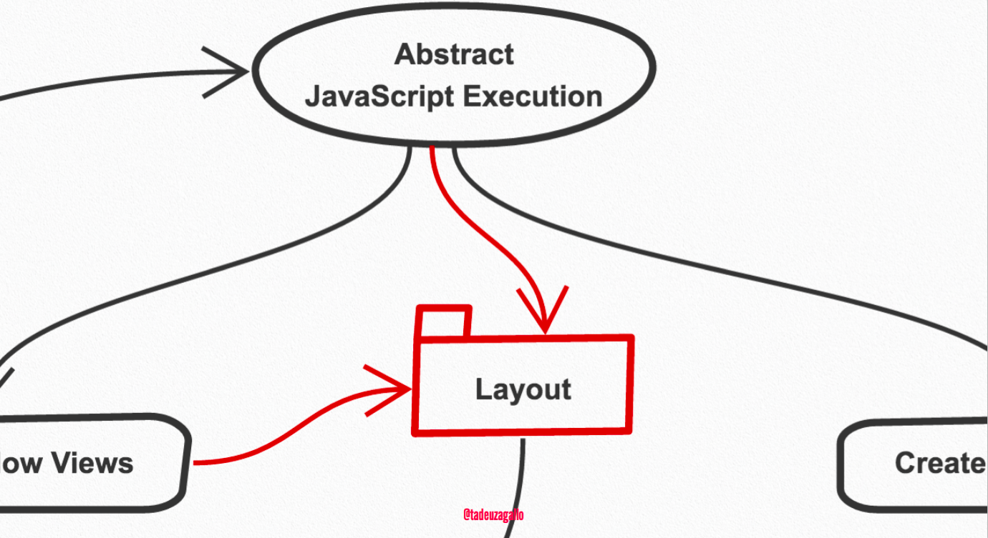

Slide 25
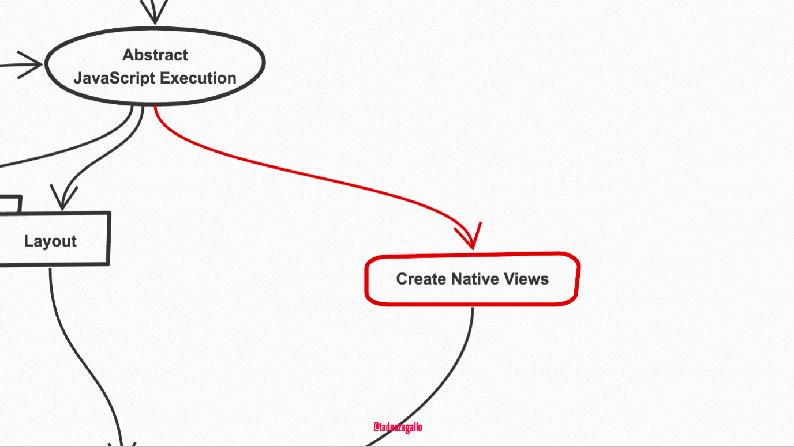

Slide 26
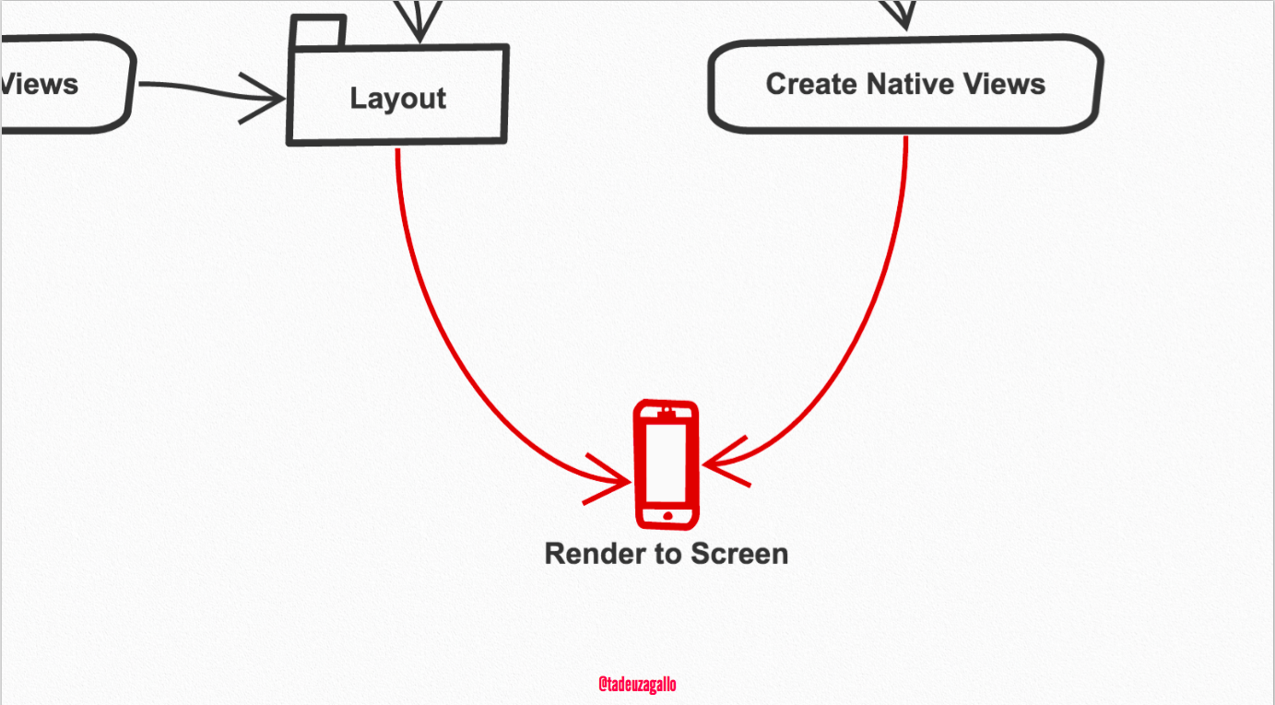

Slide 27
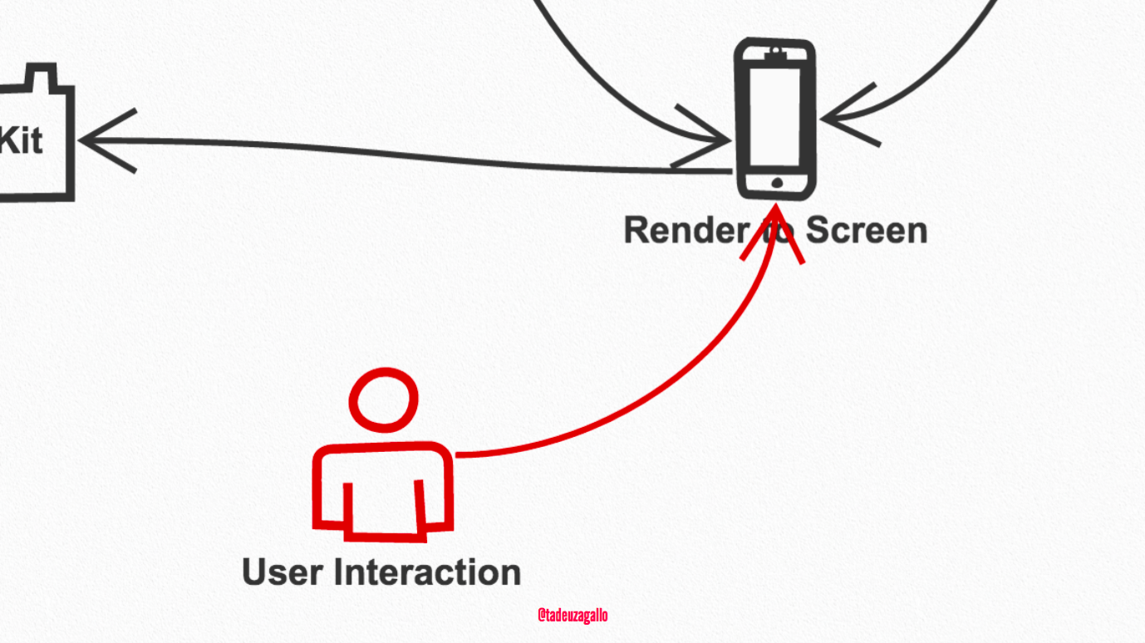

Slide 28
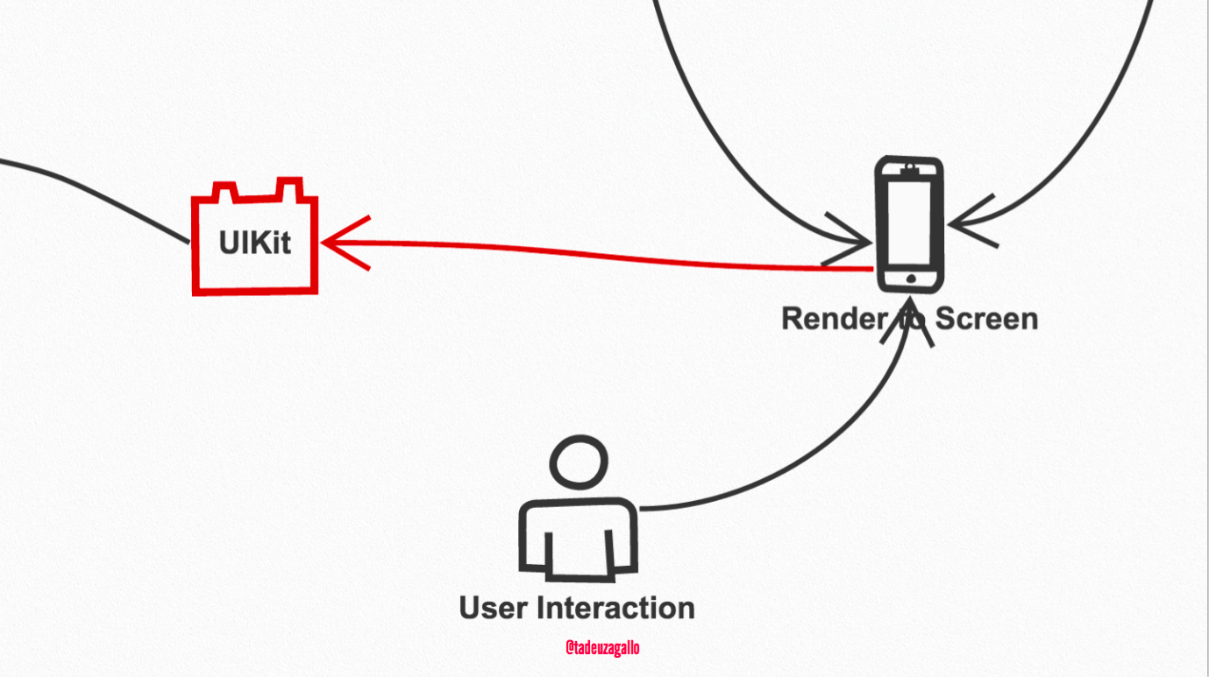

Slide 29
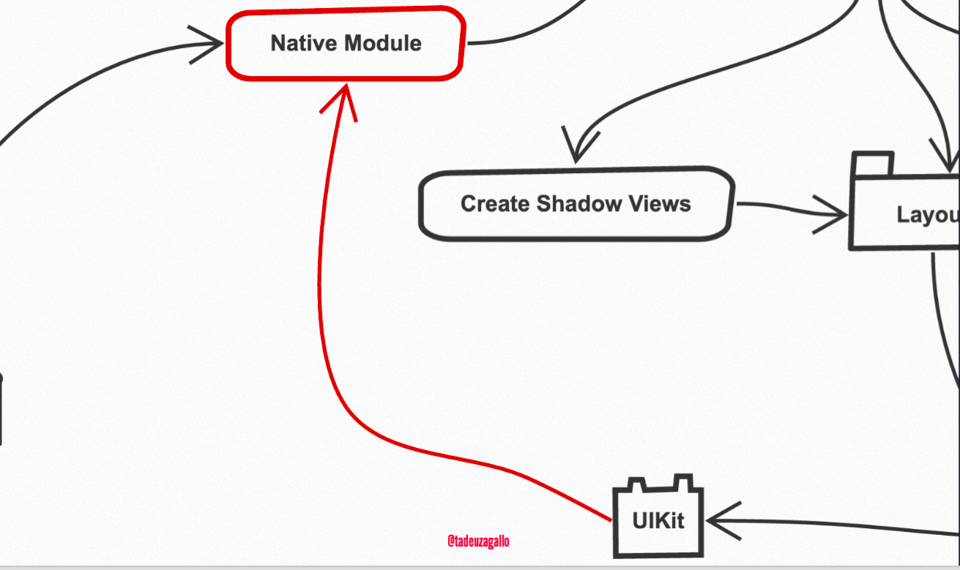

Slide 30
